Slide 1
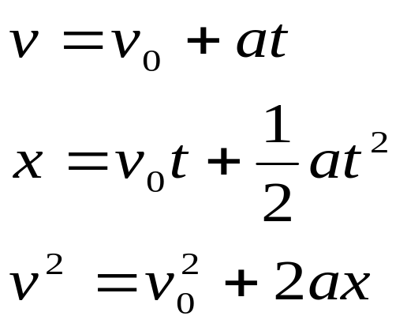
Motion with acceleration
Physics 131
Lecture 4
Today:
Examples of 3 motion equations
Position vectors
Velocity in 2D and 3 D
Acceleration in 2D and 3D
Solving problems.
All found in Young and Freedman, University Physics, Sections 3.1 and 3.2
Notes:
Today we are going to combine what we’ve learnt about motion in a straight line with what we know about vectors to help us understand and compute values for motion in a plane, or motion in 2-D or even 3-D.
Here’s a list of what you need to know from this lecture. You have this information on the handout I have given you. The handout also includes the text book references.

Slide 2

How can you achieve weightlessness
There are three ways to do it:
Go into deep space, far away from any gravitational body or balance gravitational fields, so no gravity- like at the centre of the Earth.
Go into orbit (on the Space Shuttle or the International Space Station)
Take a parabolic flight

Slide 3
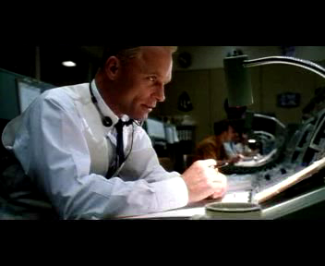
Apollo 13

Slide 4
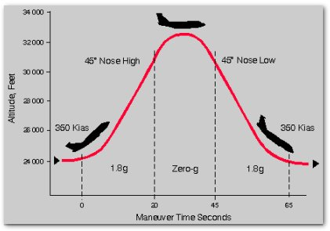
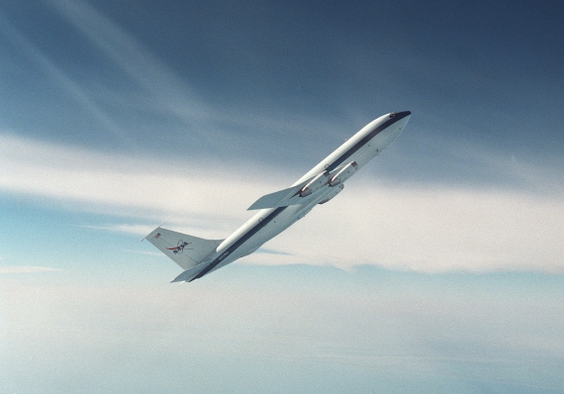
The KC-135 is a modified Boeing 707 four-engine turbojet that NASA uses to simulate conditions of weightlessness. In a typical flight, it traverses the Gulf of Mexico in a series of large parabolic arcs. Peaking at 32,000 feet, the plane then dives to 24,000 feet, its fuselage pitched down at 40 degrees. At the top of the parabola, passengers lose all sense of gravity and become weightless for a period of roughly 25 seconds. When the airplane comes out of the dive and begins its next ascent, the plane pitches upward at about 50 degrees and passengers on the craft are subjected to forces up to 1.8 times that of gravity. This climbing and diving is repeated thirty times in what might be described as the ultimate roller coaster ride. Flying on the KC-135 nauseates passengers so frequently, however, that the plane has been nicknamed the "Vomit Comet".

Slide 5


Slide 6


Slide 7
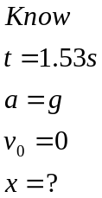
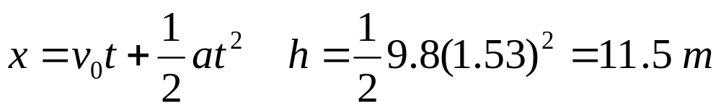
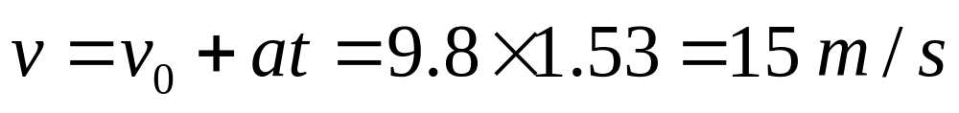
Example: FTroop
Due to the wheel coming off the cannon,Vanderbelt jumps out of the Guardtower taking 1.53 seconds to hit the ground.
How high is Vanderbelt in the Guard tower?
What is Vanderbelts vertical velocity v_{y} on hitting the ground?

Slide 8

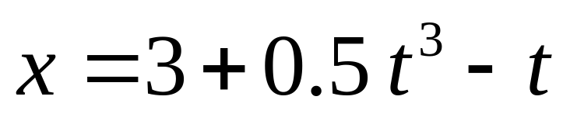
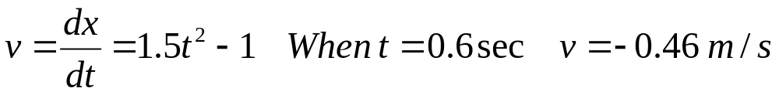
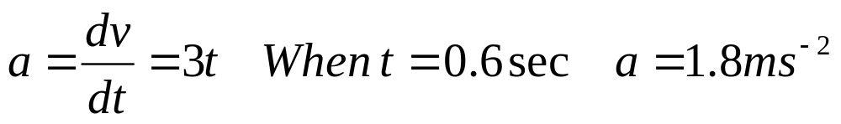
Example: Runner
A runner is running along a straight road.
Her displacement is given by the following equation in m/s.
Find her position, velocity and acceleration at t = 0.6 seconds.

Slide 9
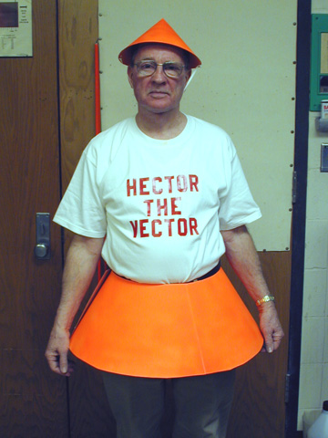
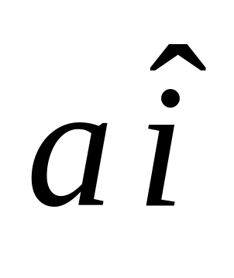
Vector Review: Any vector can be represented with a magnitude x unit vector
magnitude
direction
Eg 2.0 in the x direction can be replaced by 2.0i, where i is a unit vector in the x direction.
Notes:
Heres Hector the vector to help you remember what a unit vector is…..
His hat points in the direction of the vector….. And he is a bit of a unit…
So its one unit in a certain direction….
Multiply this by a constant and you can represent directions of all magnitudes in all directions….

Slide 10
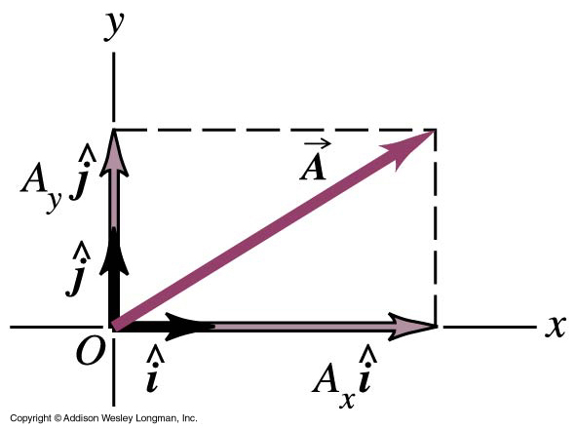
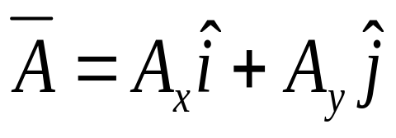
Position vectors 2D- can separate into components
Notes:
Do you remember the unit vectors we introduced in the first lecture ? In an x-y coordinate system we can define a unit vector i that points in the direction of the +ve x-axis and a unit vector j that points in the direction of the +ve y axis.
You can see that this means we can now describe the vector A in terms of its components as shown. The Ax describes the magnitude and the unit vector bit gives a direction.

Slide 11
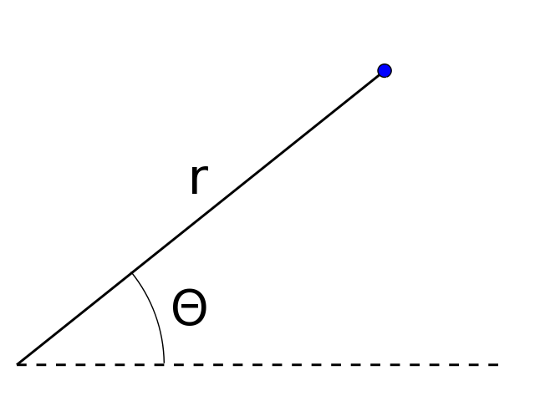
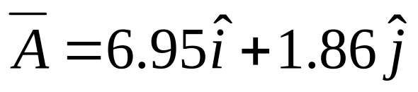
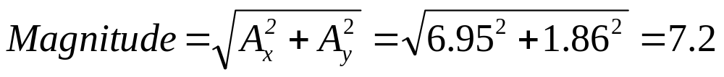
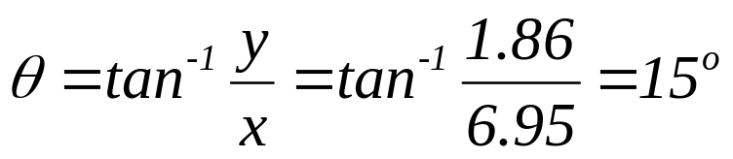
Example vectors in 2D: Convert the following vector from coordinate notation in polar form
Ie – like this. So need magnitude and direction
7.2 m
15⁰

Slide 12
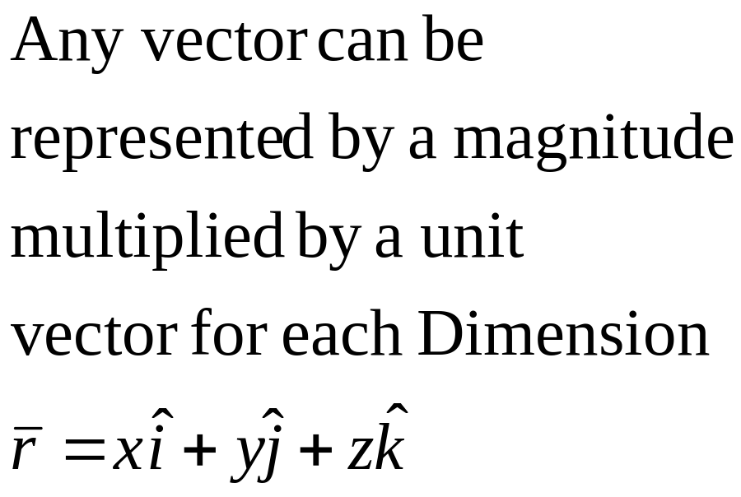
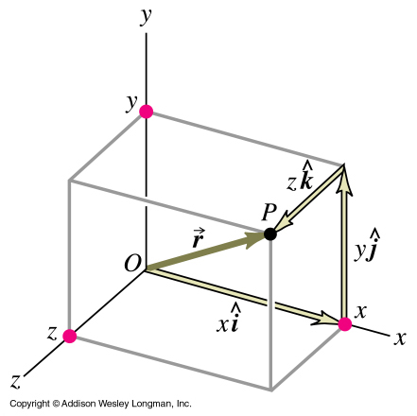
Can also use unit vectors in 3D
Notes:
We can now apply this to a position vector r in three dimensions. So the vector representing position r is simply its x component in the i direction, y in j and z in k.

Slide 13
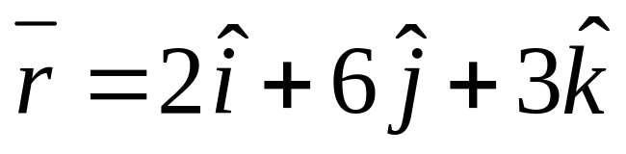
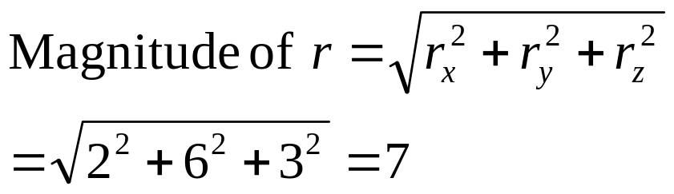
Example magnitude in 3D: Find the magnitude of a vector in 3D
Calculate the magnitude of the position vector

Slide 14
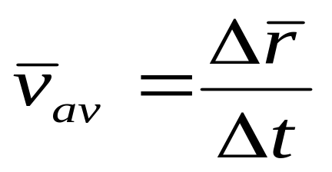
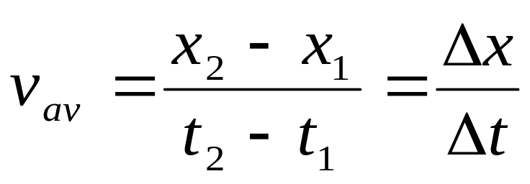
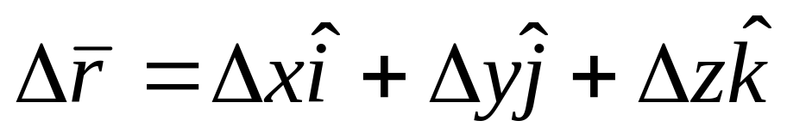
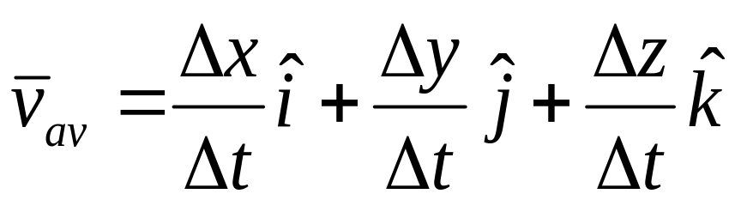
Average velocity vectors
One Dimensional
Three Dimensional
But
So
Notes:
Now we want to combine what we know about vectors with what we learnt about velocity. Remember we learnt that the average velocity is delta x/delta t for straight line motion. We can now expand that to delta r/delta t for 3-D. See that we have a hat on the vav and the r to show that they are vectors.
Delta r comprises the change in x in the unit vector i direction etc. so we end up with the equation shown. Can see that the average velocity equals the vector sum of the velocity vectors in x, y, and z.

Slide 15
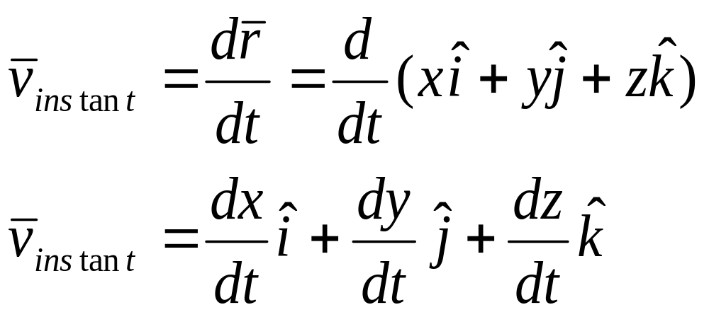
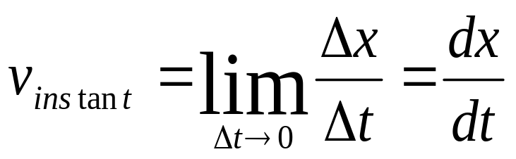
Instantaneous velocity vectors
One dimensional
Three dimensional
Notes:
Remember that instantaneous velocity was defined as dx/dt. In 3-D this becomes dr/dt (again notice the hat on the r showing it is a vector). EXPLAIN THE EQUATIONS IN 3-D
Again the differential change in r comprises the differential change in x in the unit vector i direction etc. so we end up with the equation shown. Can see that the instantaneous velocity equals the vector sum of the instantaneous velocity vectors in x, y, and z.

Slide 16
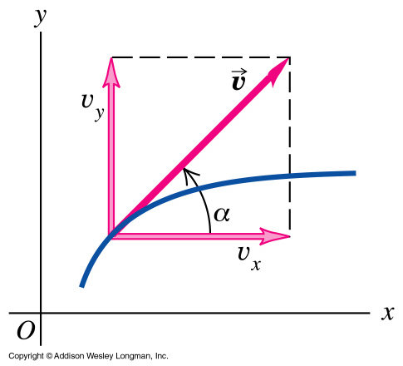
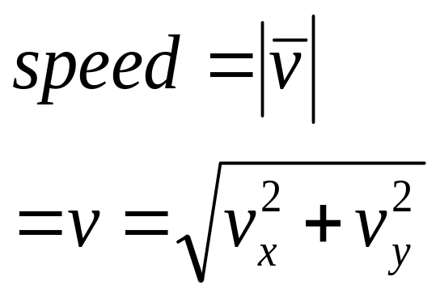
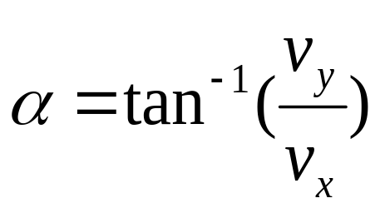
Magnitude and direction of velocity vectors in a plane- same as vector components
Notes:
So now we have the vectors and their components, what about the magnitude and direction of the instantaneous velocity ?
The magnitude is simply the speed and is the vector sum of the x, y and z components of v. In two dimensions this is as shown. It is the resultant of vx and vy.
The direction of instantaneous velocity is, as we saw in an earlier lecture, at a tangent to the path at that point.In this diagram the blue line is the particle’s path. You can see that the direction is simply given by the trigonometric equation shown.

Slide 17
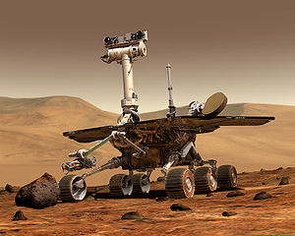
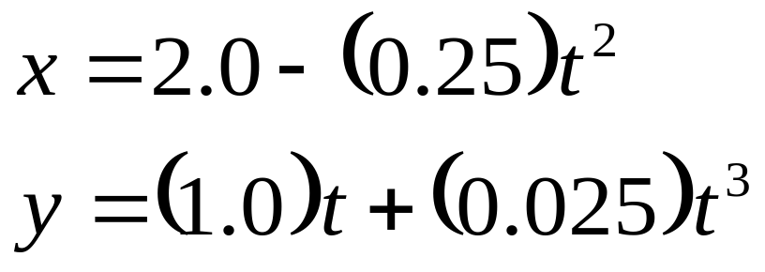
Example3.1:Mars Rover Example:
You are operating a radio-controlled Rover exploring the surface of Mars. The position (0,0) is where the Lander has touched down. The Rover has x and y coordinates that vary with time as follows:
Notes:
Let’s do Example 3.1 from the Textbook.
You are driving a Martian Rover – exploring the surface of Mars.
Here is the truth According to HP…….@
@
The Rover has coordinates according to the equataions……..

Slide 18
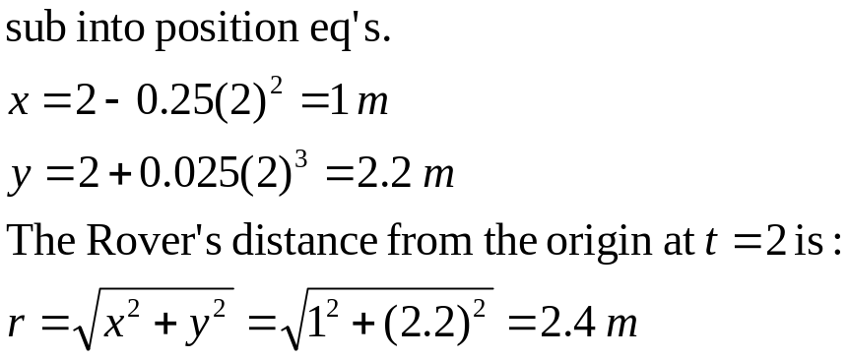
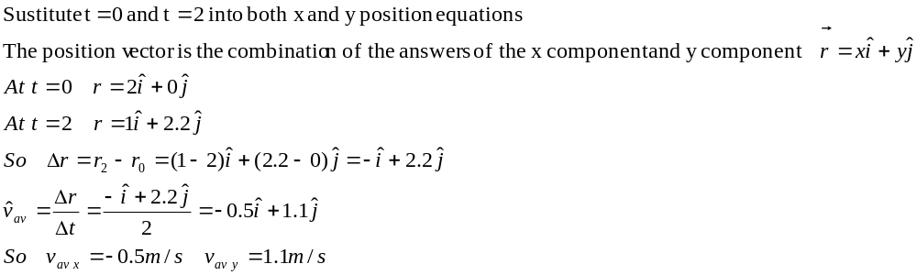
Example 3.1 Mars Rover (cont)
a) Find the Rover’s coordinates, and distance at t = 2.0 s
b) Find the Rover’s vector displacement from t = 0 s to t = 2.0 s, and its average velocity over this period.

Slide 19
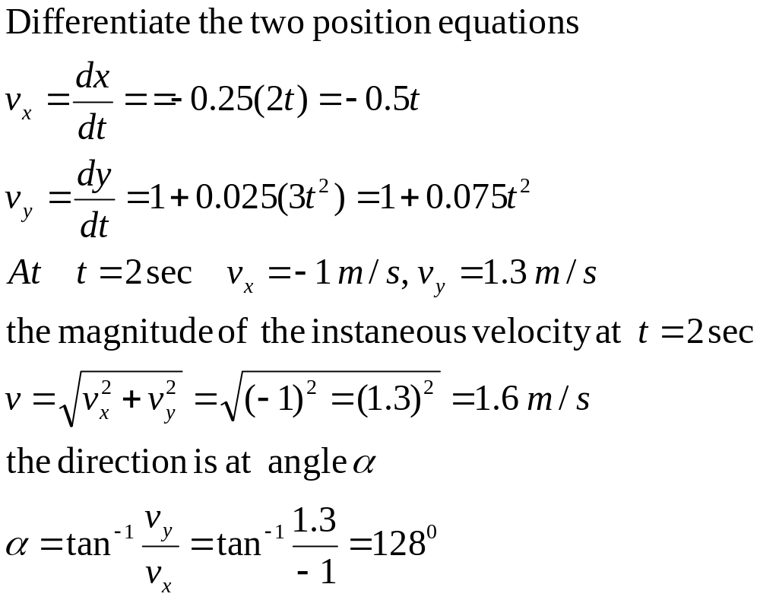
Example 3.2 Mars Rover
Derive a general expression for the Rover’s v_{instant,} and use this to find v_{instant} at t = 2.0 s. Express this in component form and magnitude and direction.

Slide 20
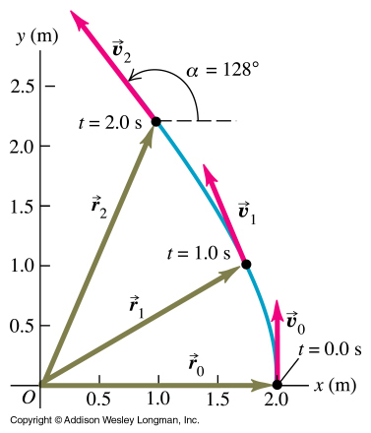
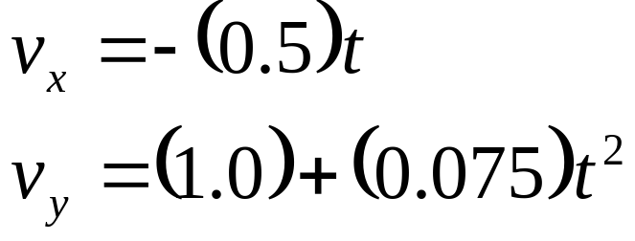
Example 3.1
Heres what's going on. This is a position map for t = 0,1 and 2 sec.
Notes:
Here’s a diagram of what’s going on.

Slide 21

What really happened on Mars according to HP

Slide 22
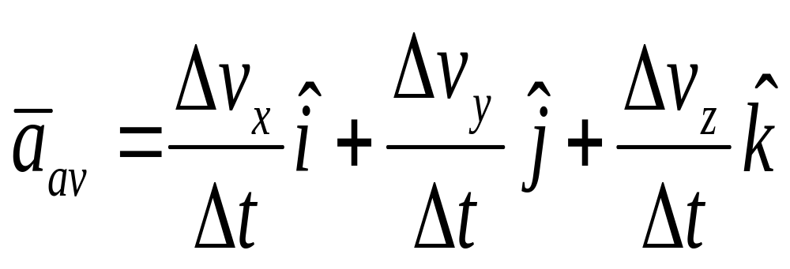
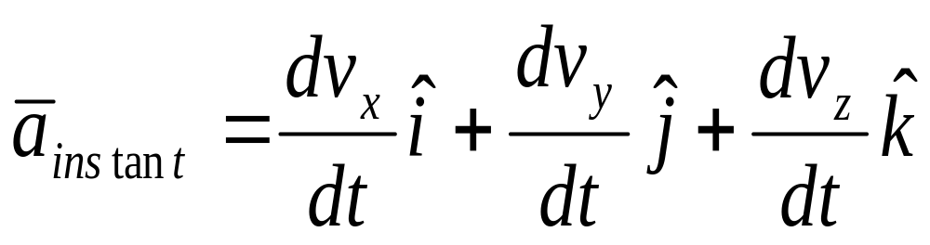
Average and instantaneous acceleration vectors… similar thing as velocity for displacement…divide by time
Notes:
When we go from 1-D to 2 or 3-D we find the same holds for acceleration as did for velocity and so we get the following equations for average and instantaneous acceleration vectors.
The magnitude is simply the vector sum of the x, y and z components of a, as it was for v. It is the resultant of ax and ay in two dimensions.
The direction of instantaneous acceleration is, as we saw for velocity simply given by the trigonometric equation, angle = arctan ay/ax. Always draw a diagram so can see where the angle should be going (ie upwards from +ve x etc).
Let’s do an example Example 2.

Slide 23
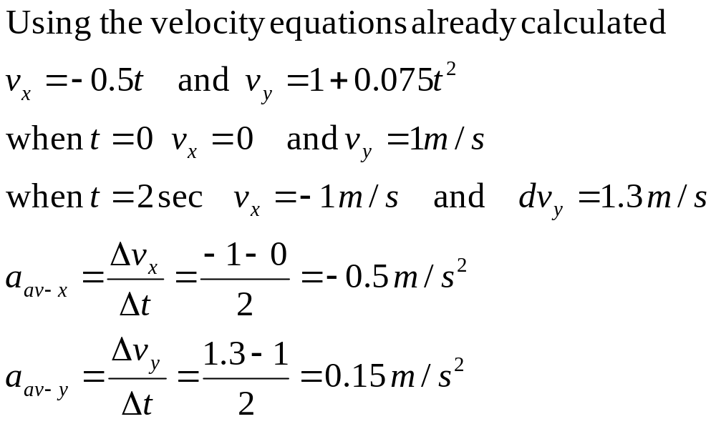
Example 3.2:Acceleration of the Mars Rover
a) Find the components of average acceleration in the interval from t = 0 to t = 2 sec.

Slide 24

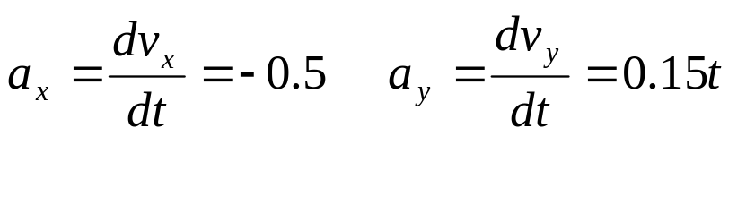
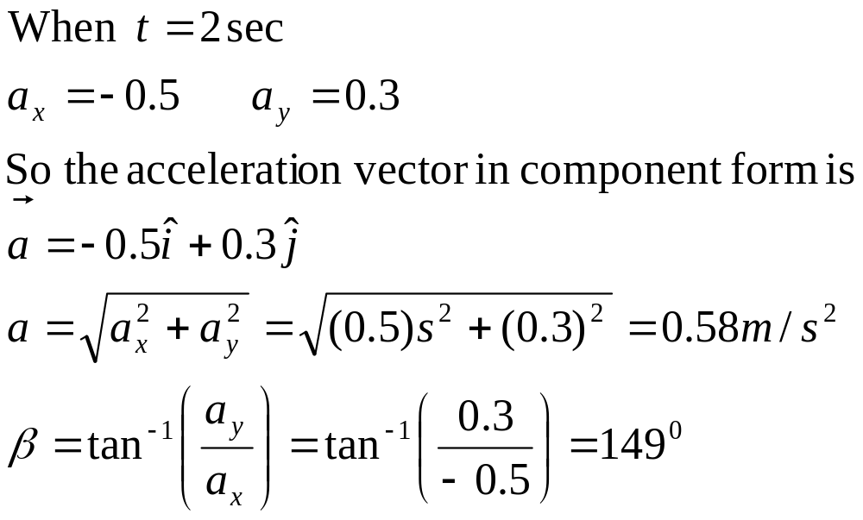
3.2 Mars Rover (cont)
b) find the instantaneous acceleration at t = 2 sec.

Slide 25
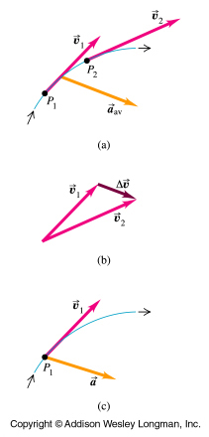
Change in magnitude or direction of velocity produces acceleration
The instantaneous acceleration vector of a moving particle always points towards the concave side of a curved path
Notes:
What about the direction of the instantaneous acceleration vector when the particle’s path is curved ? In this picture you can see that the velocity vector points at tangent to particle’s path. In the second picture v1 and v2 are drawn to show in what direction delta v goes for this case where the particle is moving in a curve.The acceleration is in the direction of delta v. In this case that places the direction of a as shown in the bottom diagram. The instantaneous acceleration vector of a moving particle always points towards the concave side of a curved path (towards the inside of a turn that the particle is making).

Slide 26
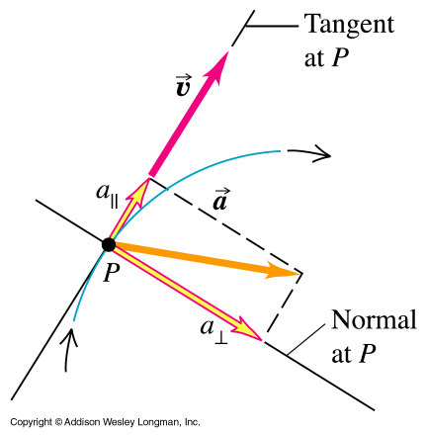
Parallel and perpendicular components of vector a
The instantaneous acceleration vector can be separated into a component parallel to the velocity vector = tangential acceleration and perpendicular to it = radial acceleration
Notes:
This picture shows a particle’s curved path, with its velocity vector at a tangent to the particle’s path. The accn vector points towards the concave side of the curved path. You can see that the acceleration vector can be separated into a component parallel to the velocity vector and perpendicular to it. Why bother ?

Slide 27
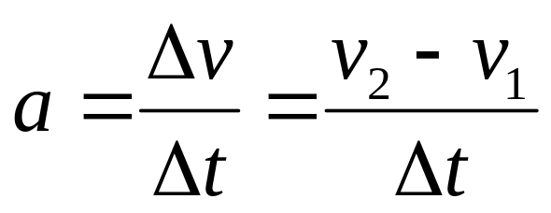
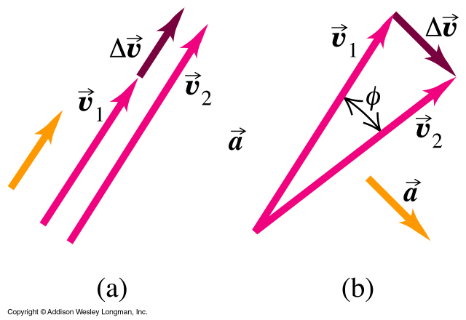
Acceleration produced by changing magnitude of velocity
Acceleration produced by changing direction of velocity
Notes:
Well, when the accn vector is parallel to the velocity vector as in a, the magnitude of v changes but not the direction so the particle stays in a straight line motion. When the accn vector is perpendicular to the velocity vector, as in b , it changes its direction but not its magnitude.

Slide 28
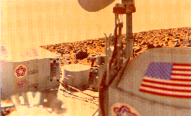
A true color image from Viking Lander 2 (1976), showing the spacecraft and part of Utopia Planitia, looking due south. The American flag, color grid, and bicentennial symbols on the spacecraft were used for correct color balance. The S-band high-gain antenna is at the top center, and the other RTG cover is at the left. The image spans an azimuth of about 140 degrees.
If you were standing on Mars, what color would the sky be?
Notes:
Talking of Mars rover- What color is the sky on Mars?
It would be blue if it wasn’t for dust….
Dust limits on Rovers….

Slide 29
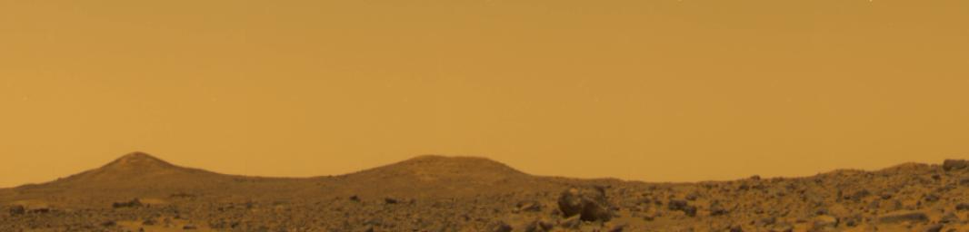
True color image from Mars Pathfinder at local noon showing the butterscotch-color sky (Image: PIA01546, sol 10). ars sky- color corrected
If you were standing on Mars, what color would the sky be?

Slide 30
